Slide 1
GitHub
By Clement

Slide 2

What is GitHub?
Think of it as an online storage for programming code
Can collaborate with others
For this crash course, no technical experience needed!
All you need is a working phone/laptop (preferred)

Slide 3

Why am I teaching GitHub?
Most popular hosting platform for software projects
Often mistakenly assumed as “common knowledge”
Even though I have been developing software for the past 3 years, I only learned about this in CMPT 276
Seems difficult at first glance, but it is quite simple and intuitive!

Slide 4

Why could this be useful to you?
If you are interested in developing software
A software you need is only available on GitHub
Your friend asks you to try out their app
For this crash course, we’ll pretend that you are in scenario 3!

Slide 5

Some GitHub terminology
Repository (Repo): Think of it as a space to hold a project, like a EDUC 100W folder on your computer that holds your assignments for this course.
Commit: In simple terms, it’s like saving your changes. When you commit, your changes are uploaded.
Code: Doesn’t necessarily have to be programming code, even files, images, anything in the repository count as well.

Slide 6

Create your GitHub account!
https://github.com
Sign up using your email
Let me know your username once you are done
Head to this link afterwards
https://github.com/chl55/github-tutorial

Slide 7
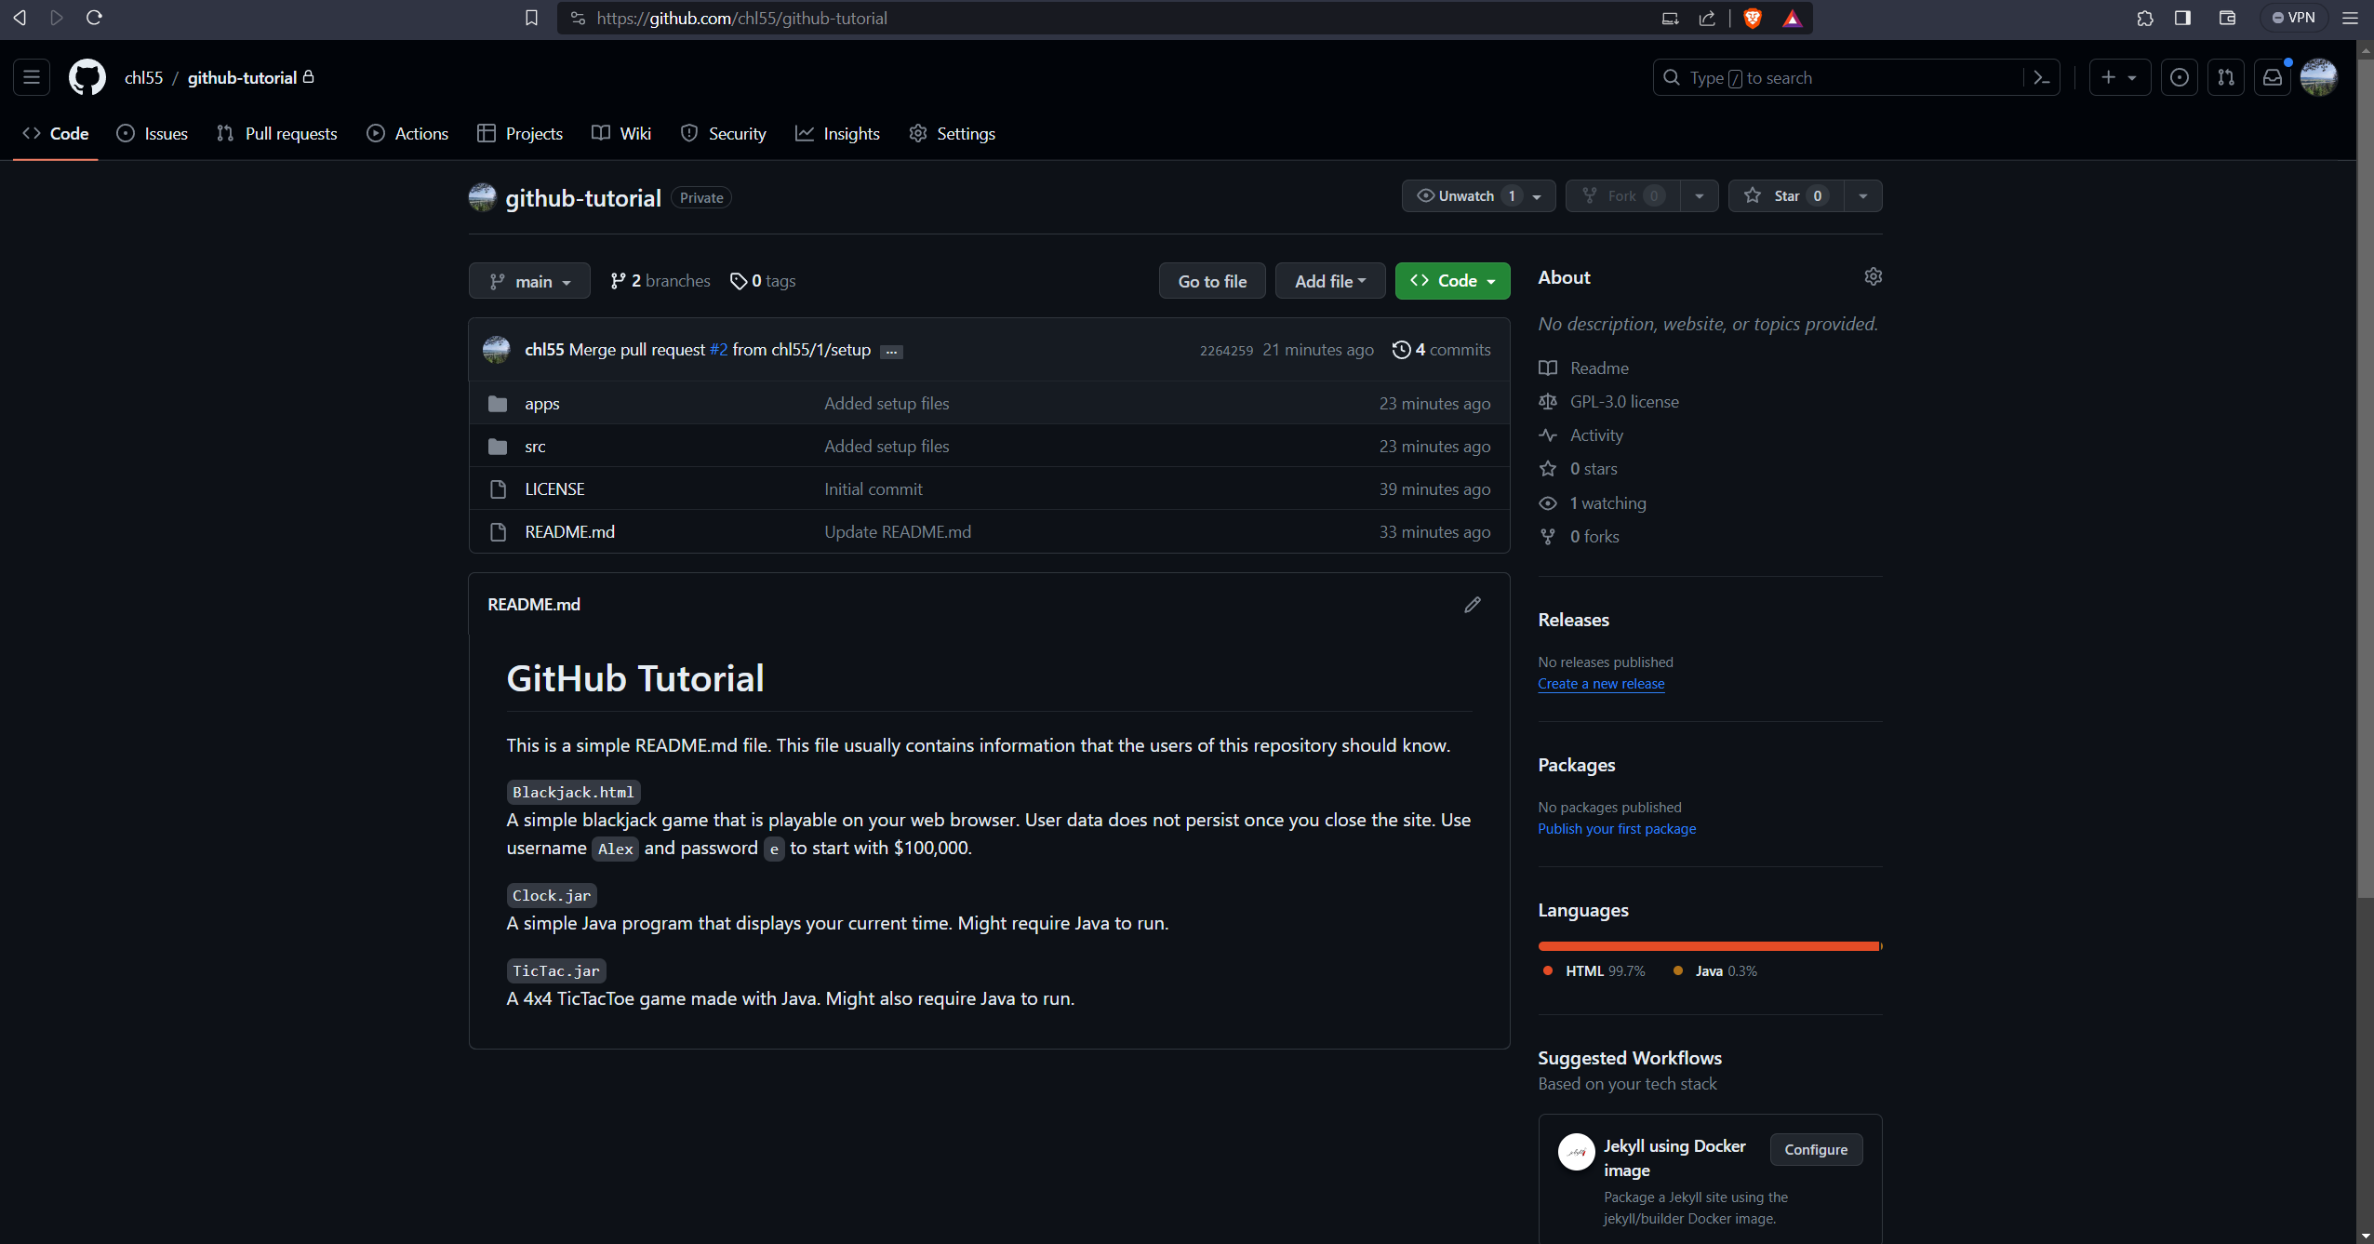
You should see something like this!

Slide 8

Project Structure
README.md: Contains information the user should know
LICENSE: License of the project
src: Contains the source code
And some other folders and files

Slide 9
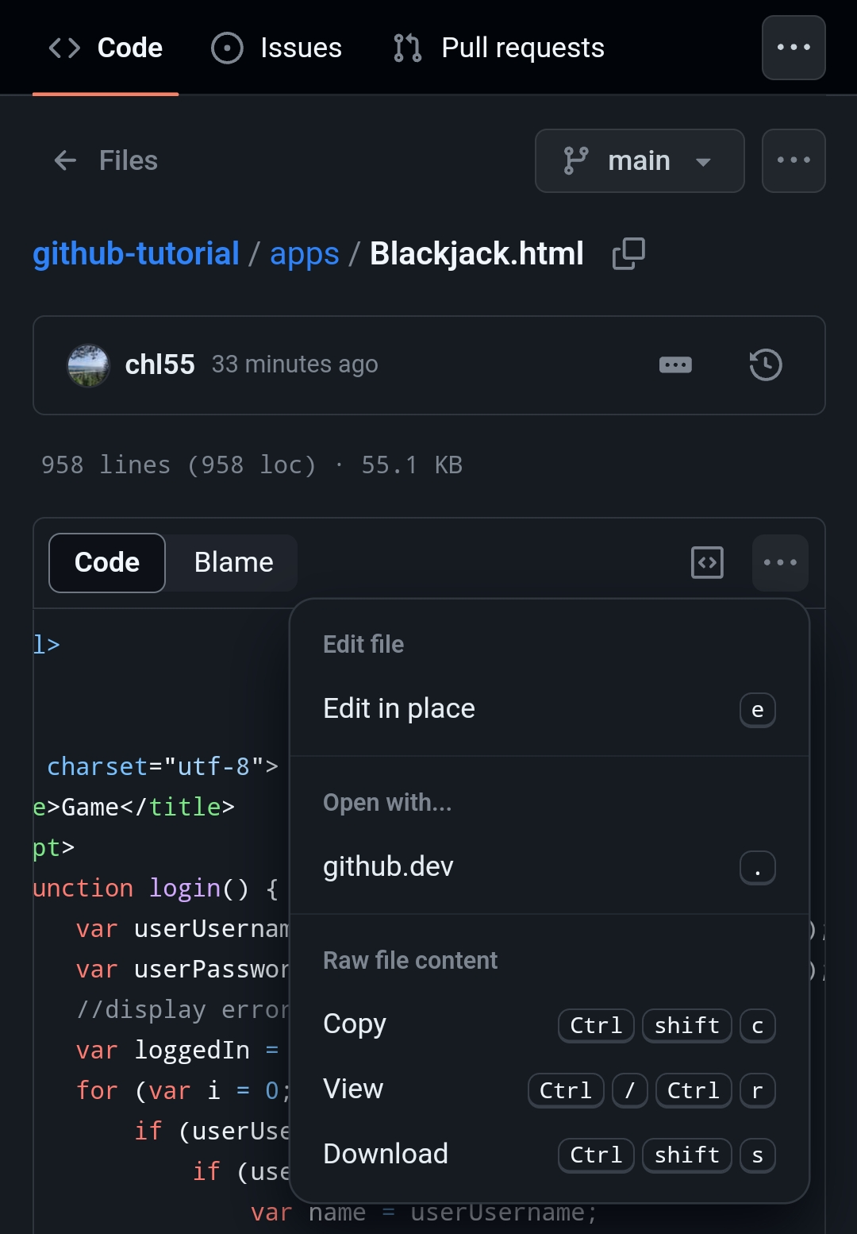

Download a file
For this step, you will download some files
Click on the apps folder and you should see three files
For mobile: download Blackjack.html
For laptops: download any of the two files
Next, try to run it! If you downloaded Clock and it not work, download the Blackjack!

Slide 10
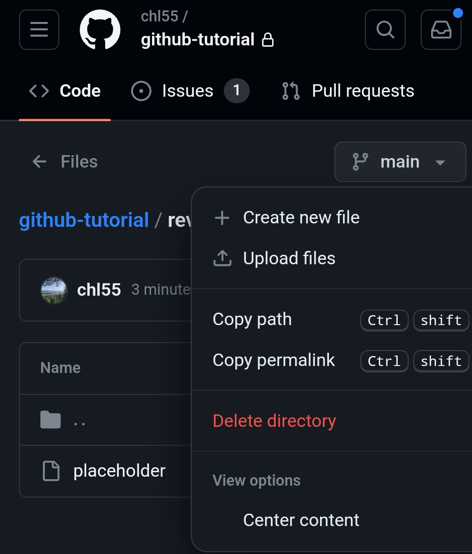

Add your review!
Imagine your friend wants you to add your review of the app.
Go to the reviews folder, then click on Create new file
Name your file after your first name
Enter your review! (If you can’t think of anything, just type in “Hello World!”)
Once you are done, click on “Commit changes”
You can modify your commit message (optional)
Click on “Commit changes” once you are done!

Slide 11

Great job!
You have successfully published your review onto the repository!

Slide 12
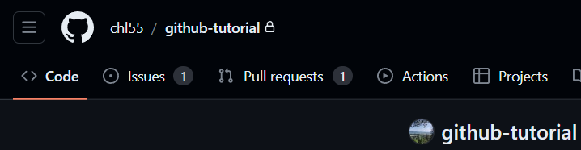
Something more advanced
Code: Where the code is located
Issues: You can create issues for issues related to the code! You can create issues for features, proposals as well!
Good rule of thumb: When you want to make changes to the code, create an issue about it!
Pull requests: The name is a bit misleading, but it means merging your branch that contains code into the default branch (usually main). Instead of pull request, maybe it should be renamed to merge request!

Slide 13
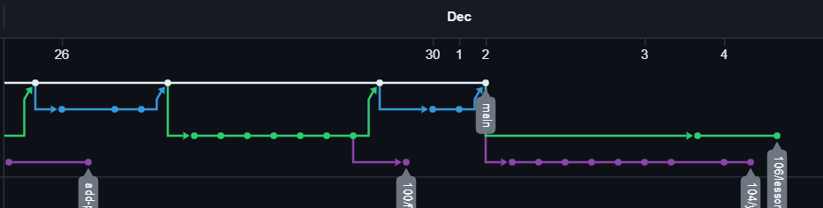
So, what are branches?
Recall commits – they are snapshots of changes
You can think of branches as a series of changes
The “default” branch is usually named main or master
You usually create a branch to solve an issue
Once you are done, you merge your branch back to another branch through pull request

Slide 14
Why branches and pull requests?
Usually, you want to keep the main branch clean
It should always be in working condition
Commit history should be clean as well
Thus, the main branch is often protected, and you cannot commit directly
Pull requests allow others to review your code before you merge

Slide 15
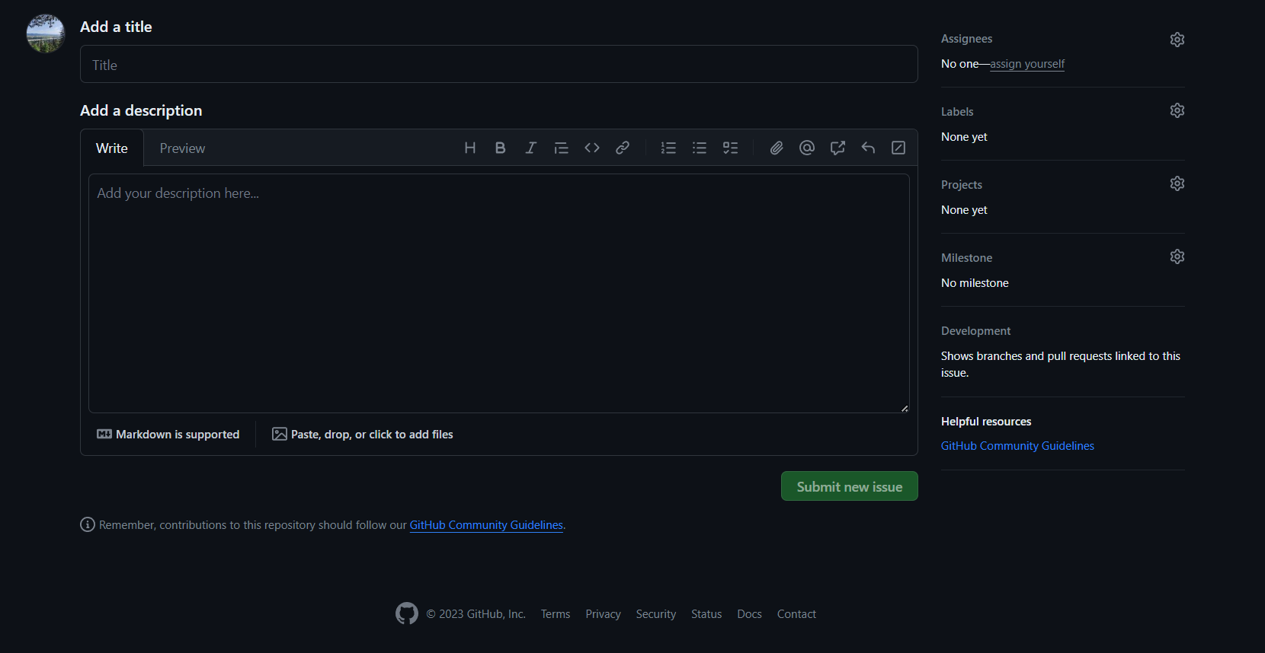
Rate the app out of 10!
Now, your friend wants you to rate their app out of 10.
Since the project is now more complicated, a branch protection rule is set up. You will have to use branches and pull requests.
To start, create your first issue! Go to the issues tab, then click on New
Title your issue “Name’s review” (e.g. Clement’s review)
Assign yourself for “Assignees”
Apply the “review” label
Select the “Add Your Review!” milestone
Click on “Submit new issue”
Once you are done, remember your issue number!

Slide 16
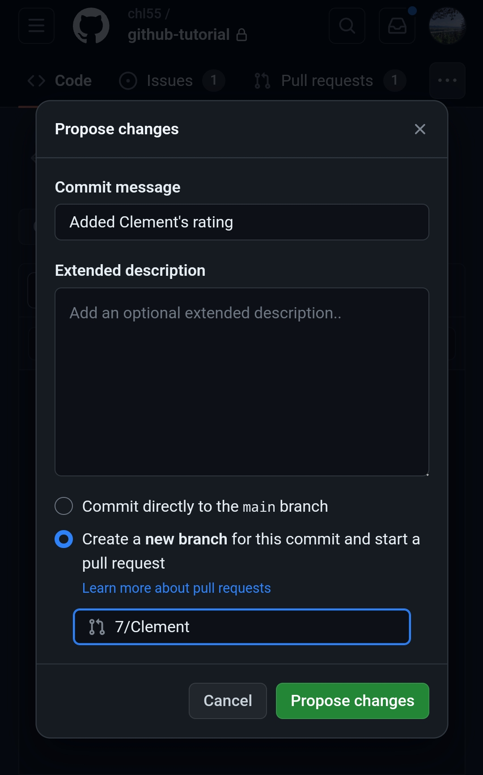
Create your rating file!
Your friend made a ratings folder to compile all your ratings
Navigate to ratings, then create a new file again. Name it after yourself
In the file, add your rating out of 10
Once again, you can enter a custom commit message if you like
Now, it will prompt you to create a new branch this time
Name your branch in the format “issue/name”. For example, 7/Clement
Click on Propose changes!

Slide 17
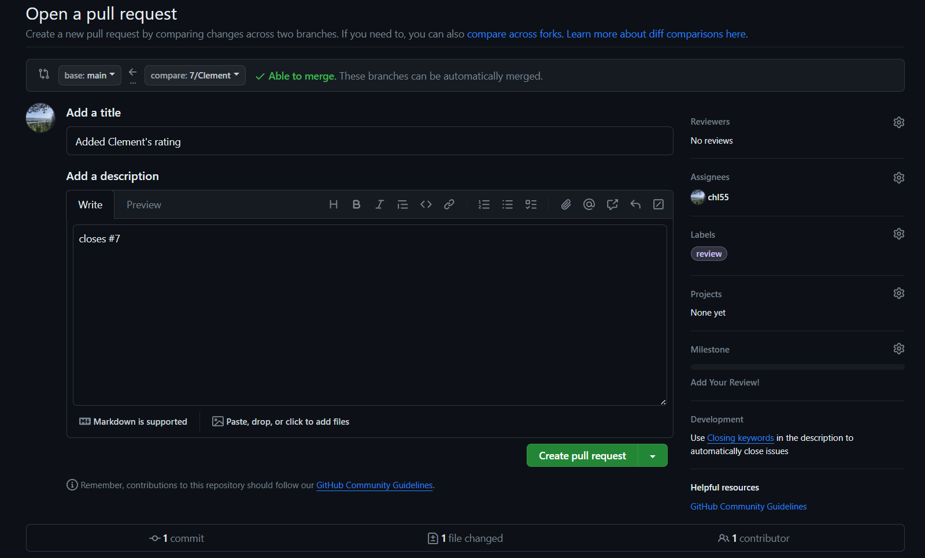
Open a pull request!
Usually pull requests require approvals from others, but we will skip that for this crash course
Once you click the button, you will be asked to create a pull request
Similarly, assign yourself, apply the review label and the “Add Your Review!” milestone
In the description, add “closes #issue”. This will automatically link your pull request to the issue you created earlier
Create your pull request!
Once you create it, you should be able to merge it into main. Click the Merge pull request button to merge

Slide 18
Congratulations!
You now know the basics of GitHub!

Slide 19

Questions?

